Slide 1

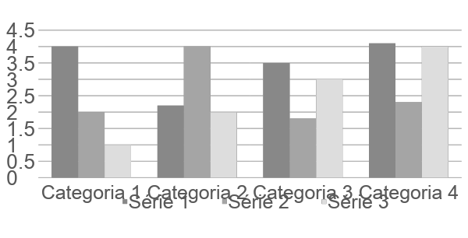
INSERT YOU INSTITUTION LOGO HERE
Insert here your
poster title
Authors: Surname, First name. Presenting author underlined,
Affiliations must be numbered in superscript¹
e.g. Sandim, Vanessa¹, Nestal de Moraes, Gabriela² and Monteiro, Robson¹
¹Instituto de Bioquímica Médica Leopoldo de Meis / UFRJ; ²Instituto Nacional de Câncer - INCA
ABSTRACT
All sections may be edited by the authors, such as the size of the font, the section distribution and the color scheme.
How to prepare your poster:
The body text: font size should be no smaller than 22 points and justify text.
METHOD
Titles should be in upper and lower case, not all capitals.
If necessary, use bold characters to emphasize your text.
Avoid overcrowd your poster.
Spell check and get someone else to proof-read it.
Abstract
Results
Conclusion
RESULTS
Images such as photographs, graphs, diagrams, logos, etc, can be added to the poster.
Avoid long tables. They will be difficult to read.
Be aware of the image size you are importing.
Graphs created in different programs (e.g.. Prism) should be saved as image (.jpeg or .tiff).
Capitions - use font no smaller than 18 pt., justitied and italic font
Captions - use font no smaller than 18 pt., justified and italic font
CONCLUSIONS
The body text: font size should be no smaller than 22 points and justify text.
REFERENCES (optional)
The body text: font size should be no smaller than 22 points and justify text.
ACKNOWLEDGEMENTS
The body text: font size should be no smaller than 22 points and justify text.
SUPPORTED BY
The body text: font size should be no smaller than 22 points and justify text.
CONTACT INFORMATION
e-mail:

